Slide 1
Visual Odometry - Abhinav Agrawal
engg.abhinav.agrawal@gmail.com

Slide 2
Project analysis slide 3
Visual Odometry Motion Estimation using Epipolar Geometry
What is Visual Odometry?
Estimating a camera’s movement in a 3D environment using sequential images.
Utilizes feature detection, matching, and motion estimation.
Objective of the Project:
Detect corresponding feature points in consecutive images.
Compute the Essential Matrix to estimate camera movement.
Decompose the Essential Matrix to obtain rotation (R) and translation (t).
Compare estimated motion with ground truth.

Slide 3
Project analysis slide 8
Implementation
Implementation Steps
Key Code Components
Load and preprocess images.
Extract feature points using ORB.
Match key points using FLANN-based matcher.
Compute the Essential Matrix and extract motion parameters.
Visualize camera trajectory and compare with ground truth.
visual_odometry.py: Core visual odometry pipeline.
image.py: Image processing utilities (feature matching visualization).
camera.py: Camera pose plotting functions.
video.py: Frame-by-frame visualization.
plotting.py: Path plotting using Bokeh.

Slide 4
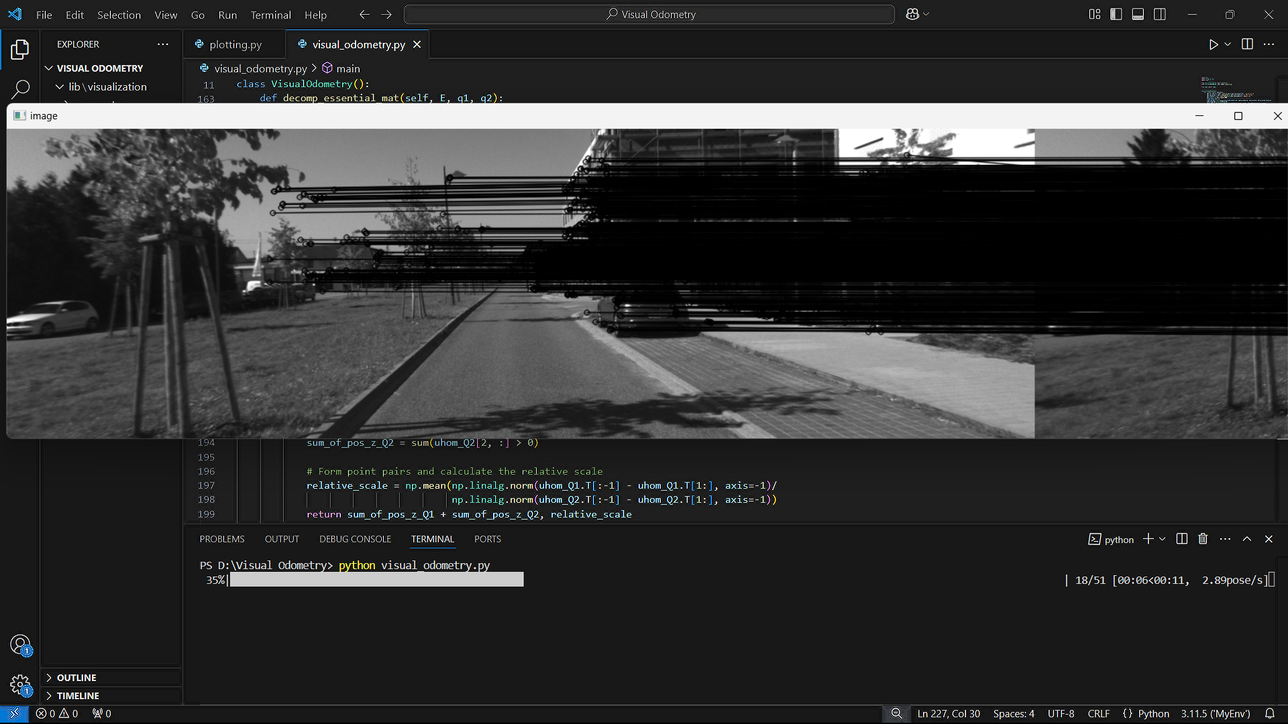
Project analysis slide 10
Results
Feature Matching Visualization:
Left: Original frame, Right: Next frame with matched key points.
Black lines indicate matched feature correspondences.

Slide 5
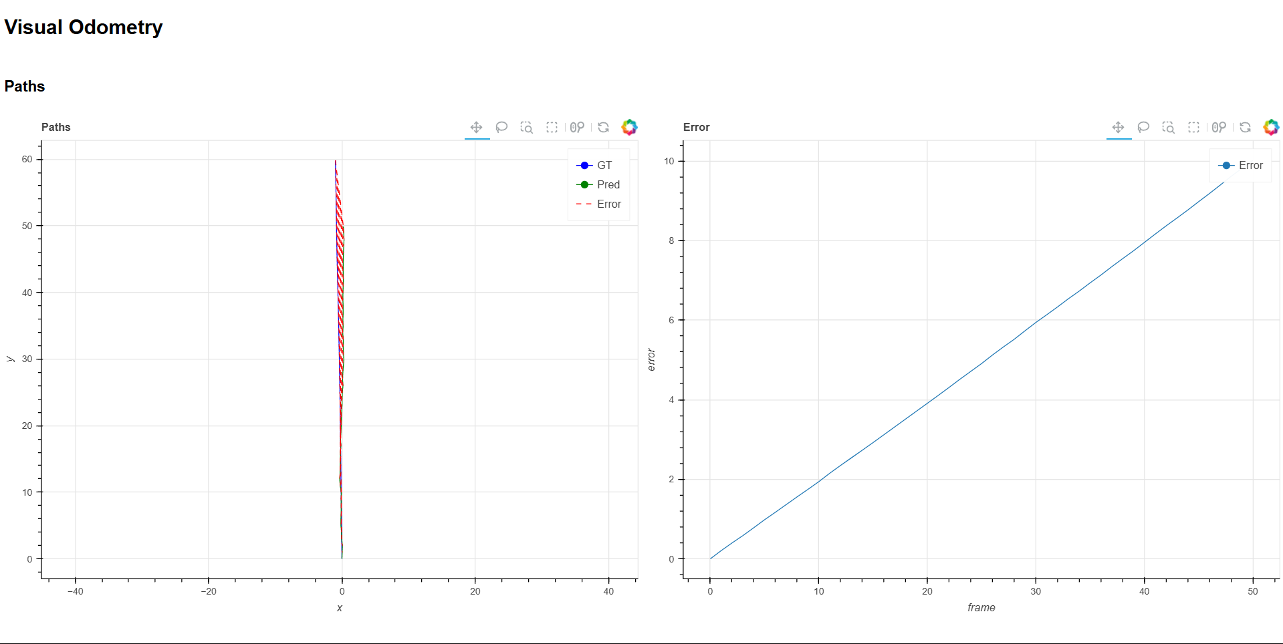
Project analysis slide 10
Results
Trajectory Estimation:
Left Graph: Ground Truth (GT) vs. Predicted (Pred) Paths.
Right Graph: Error progression over frames.
Observations: Model struggles with drift in long sequences.

Slide 6
Thank You

